Slide 1

Evolving Southeast Asian e-commerce.
Pushing the Boundaries of ASEAN e-commerce.
Pushing e-commerce in Southeast Asia Forward.

Slide 2
ASEAN-Ecom
Who are we:
ASEAN-Ecom is a group of globalized professionals who have a "zeal" in advancing and developing the Southeast Asian e-commerce infrastructure.
What we do:
We are creating an e-commerce ecosystem by using technology to build an online payment platform, online trading sites and smart logistics.
Why we do it:
We want to solve the market problems that e-commerce faces and bring the convenience of doing business online to the people of Southeast Asia.
We support more economic growth and also open up many dormant opportunities such as web services, apps with freemium models, etc. We hope to shape e-commerce as a lifestyle.

Slide 3
ASEAN e-Commerce Landscape
Rise of Southeast Asian middle class population.
Increasing Mobile, Internet and Credit/Debit Card penetration.
The ASEAN E-Commerce is worth approximately $34.5 billion by 2018.
Shopping Online is predicted to become a lifestyle for the people of this region in the near future.
The ASEAN Economic Community (AEC) will open borders and stimulate trade and commerce across Southeast Asia through better logistics capabilities.

Slide 4




ASEAN e-Commerce Challenges
Payment System
Consumer Behaviour
Security
Logistics
Low credit card penetration. Opt for cash on delivery.
Do not see the benefit of putting their cash in banks.
Existing payments systems fall short of creating trust.
Emphasis on inspecting the product before buying.
Many online marketplaces provide vague descriptions and pictures to illustrate products. General skepticism on digital content.
Poor privacy policies.
Identity theft and unauthorized bank account access.
Illegitimate online marketplaces.
Various consumer frauds.
Poor infrastructure planning.
Lack of technological adaptations to existing services.
Deliveries often get stolen/lost or are late upon arrival.

Slide 5
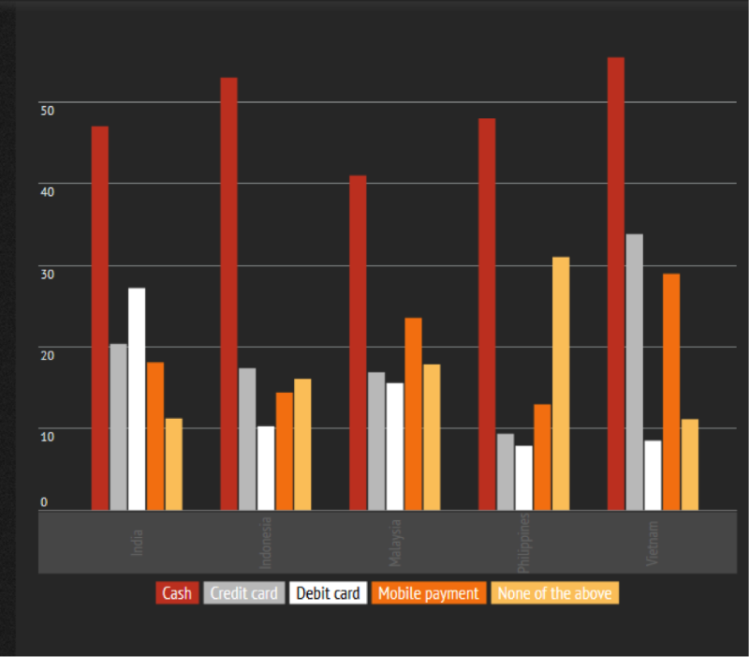
India
Indonesia
Malaysia
Philippines
Vietnam

Slide 6

Solution

Slide 7
Introduction to the Solution
ASEAN Ecom aims to advance and develop the Southeast Asian e-commerce infrastructure by building a sustainable e-commerce ecosystem.
Secure Integrated Payment Platform
Social Media-based E-Retail Platform
Smart Logistics

Slide 8
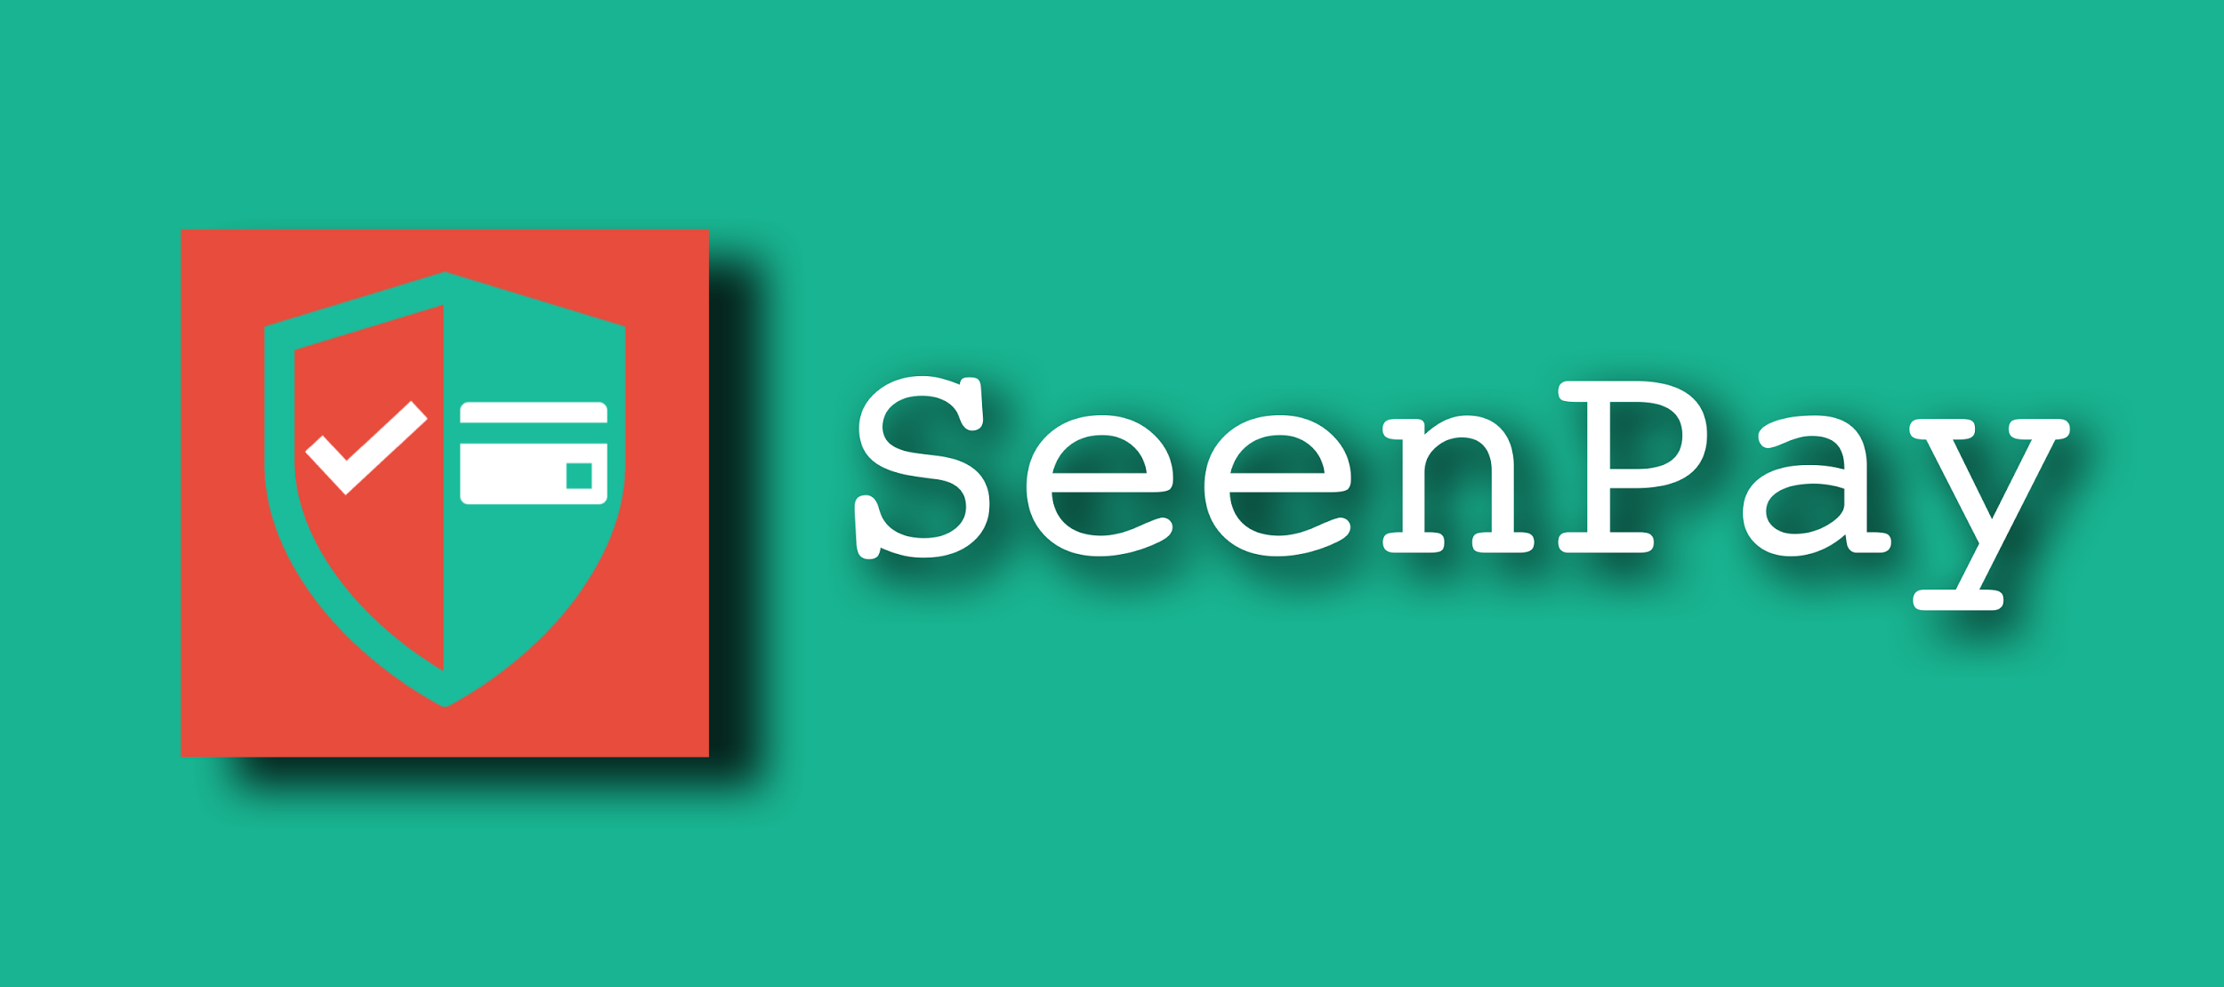


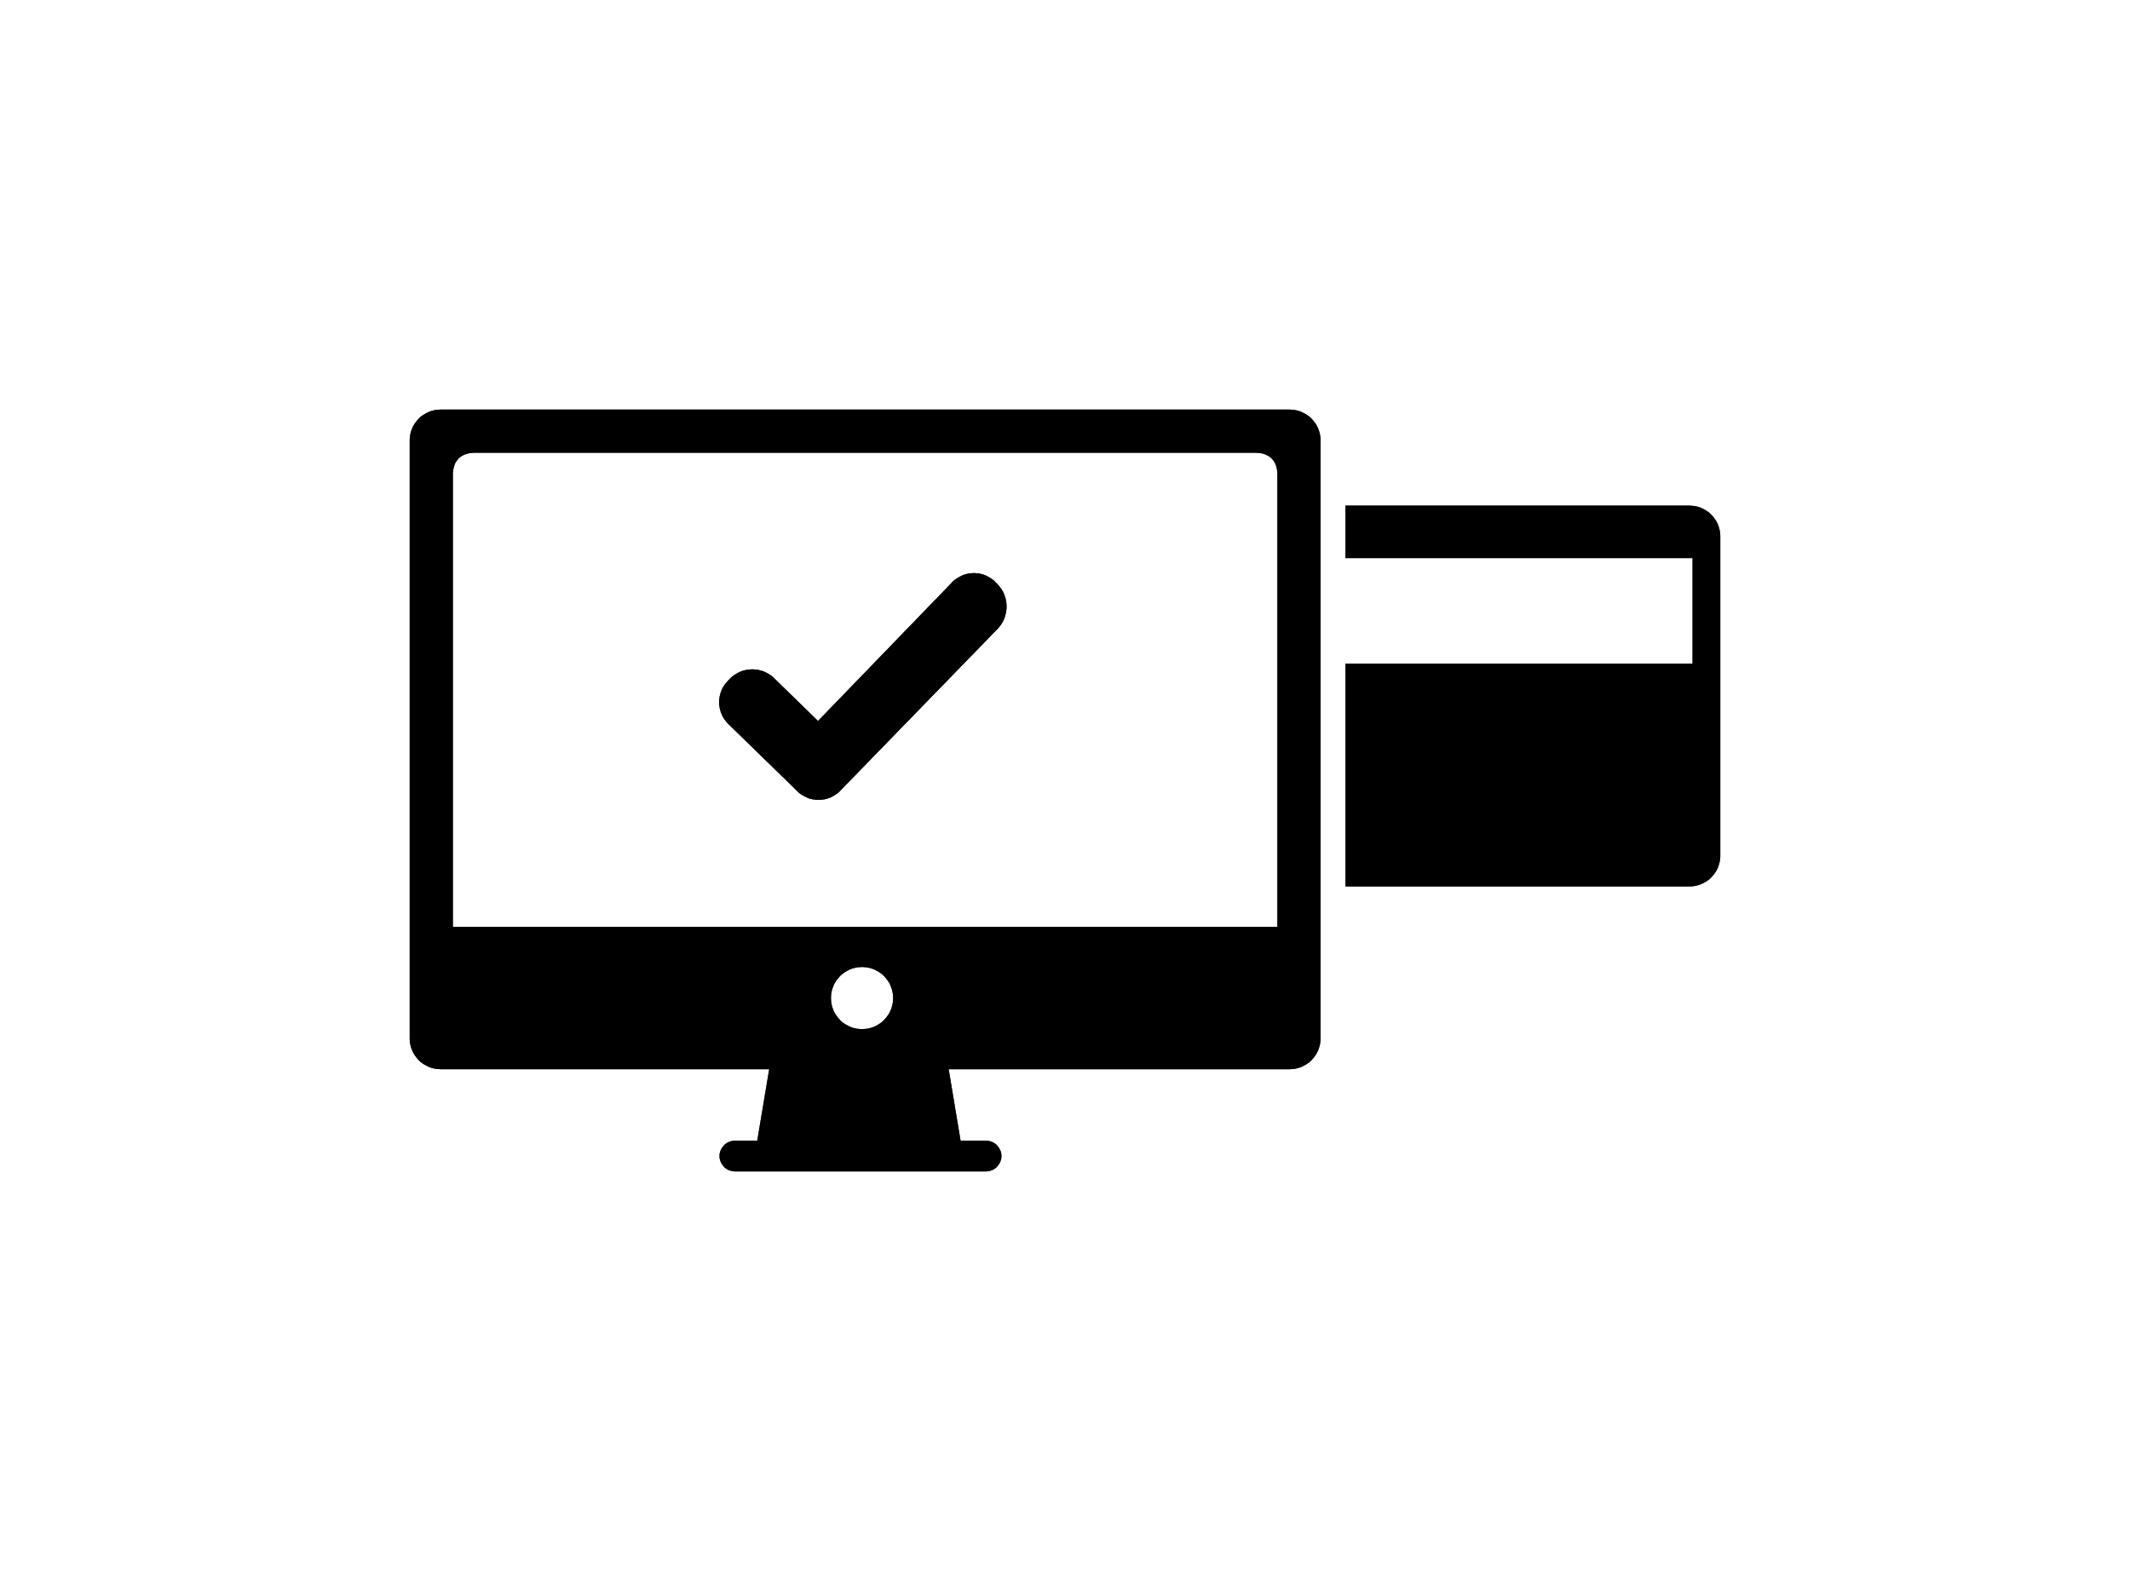


SeenPay
The solution to further expand logistical development.
Opens up dormant services e.g. web services, freemium apps, etc.
A secure user-friendly integrated payment platform.
The key to generating “trust” during online trading.
Intends to resolve the cash on delivery (COD) barrier.
Uses the latest PCI Data security standards.
*SeenPay’s detailed scheme is available upon request.

Slide 9


Online Marketplaces
AsiaticMall.com
An online marketplace that allows Sellers from different countries in Asia to trade with one another.
Lucloi.vn
C2C online marketplace for Vietnamese consumers.

Slide 10

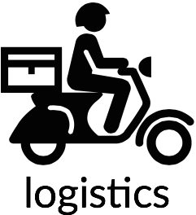
Smart Logistics
Link to P2P Logistics
https://drive.google.com/open?id=193tngmgf5vKFhmL8qwdZZtDUL8iHn1w3mao5SaMS_8Q
*SeenPay Logistics
A service that
Picks ups - Packs – Ships the item.
Delivery service model is also inspired by Uber’s hiring concept.
*Subject to change.

Slide 11
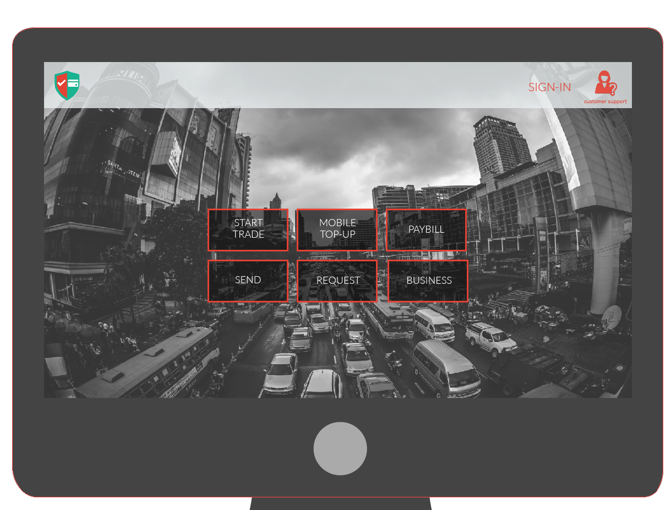
User Experience Outline

Slide 12
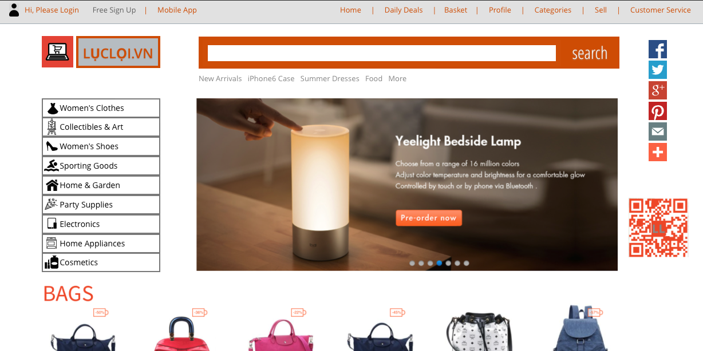
User Experience Outline

Slide 13









Competition

Slide 14
Competitive Advantages
Payment
Logistics
Online Marketplace
More Versatility
A lifestyle payment platform all in one. From paying utility bills, buying movie tickets to paying for a date’s meal discretely.
More Relevant
Users get to follow trendsetters and view a feed of items suited to their interest.
Flexible
Registrants can earn from delivering by customizing their schedule to the available delivery tasks days ahead.
Easier
Sell and buy anything with one click of a button. Just like social media, users get to share the items they are selling or buying. Including an instant chat feature to make deals happen. (C2C)
Smarter
Personalization provides better user experience. Offer users different methods
Notes:
….. (mention escrow?

Slide 15





Stages of Development
Current Phase
Phase II
Phase III
Further research on the market situation.
Refining ASEAN-Ecom’s strategy and recruiting members.
Developing and enhancing solutions i.e. payment platform.
Undergo rigorous product testing.
Introduce functionality to wider audience and appeal investors.
Official Launch of SeenPay and Lucloi.vn in Vietnam.
Logistics work-around through 3rd party partnership.
Finalize cross border-trading for AsiaticMall.com - possible through (AEC)
Start Marketing Ploy.

Slide 16
TEAM
Huy Le
Cheryl Fong
Dac Khue Nguyen
Mayphyu Aye

Slide 17
User Experience Outline

